Slide 1

Welcome to Spring 3.0 Chapter 5 – Spring Security

Slide 2
Chapter 5 – Spring Security
Spring Security | What is Spring Security?
 | Acquiring and Integrating Spring Security
 | HTTP BASIC authentication(Basic and Form Login/logout options)
 | Authorisation
 | Security Interceptor, Filters
 | Authentication Manager & provider, Authorization Manager & provider
 | Advance concepts and integration

Slide 3

What is Spring Security?
Spring Security provides comprehensive security services for J2EE-based enterprise software applications. Its powerful, flexible and pluggable.
There is a particular emphasis on supporting projects built using the Spring Framework, which is the leading J2EE solution for enterprise software development.
Its not Firewall , proxy server, intrusion detection system, OS security, JVM security etc.
Notes:
Other principals: device, other system
These concepts are common, and not at all specific to Spring Security

Slide 4

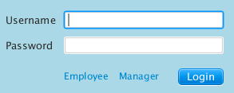
Major operations
Authentication(Prove who you say you are!) - process of estabilishing a principal (user, system etc. which can perform an action in application)
Authorization(We know who you are but are you allowed to access what you want) - process of deciding wheather a principal is allowed to perform an action(access-control -> admin, leader, member, contractor, anonymous etc.)
Authentication process establishes identity of the principal,
which is used for authorization decision.
Identification
Verification
Notes:
Other principals: device, other system
These concepts are common, and not at all specific to Spring Security

Slide 5
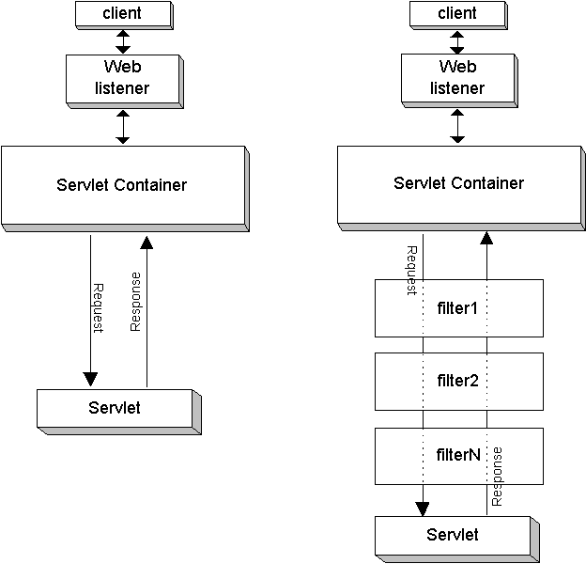
Servlet Filters
Notes:
Other principals: device, other system
These concepts are common, and not at all specific to Spring Security

Slide 6

Security Use Case
Logoff
Hello
(secure Area)
User Authenticated
Spring Security
Auth Failure
Homepage
Login page
Credential Check
Auth Providers (plain text, hash. DB etc.)
Notes:
Other principals: device, other system
These concepts are common, and not at all specific to Spring Security

Slide 7

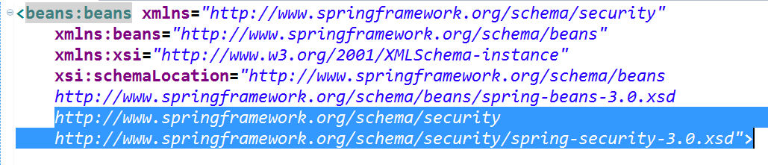
SPRING SECURITY SETUP
JARs
Schema
Notes:
Other principals: device, other system
These concepts are common, and not at all specific to Spring Security

Slide 8
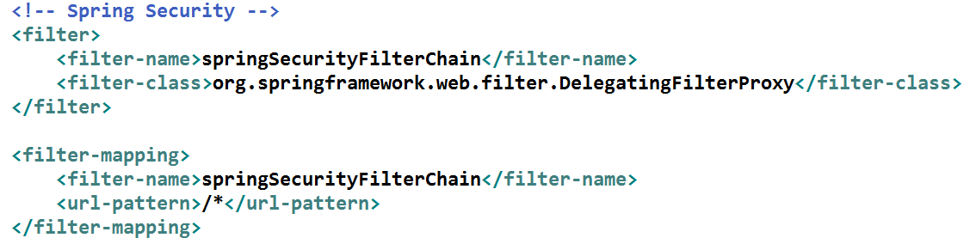
Configuration 1
WEB-INF/web.xml:
Proxies requests to a bean with ID “springSecurityFilterChain”
Notes:
Other principals: device, other system
These concepts are common, and not at all specific to Spring Security

Slide 9
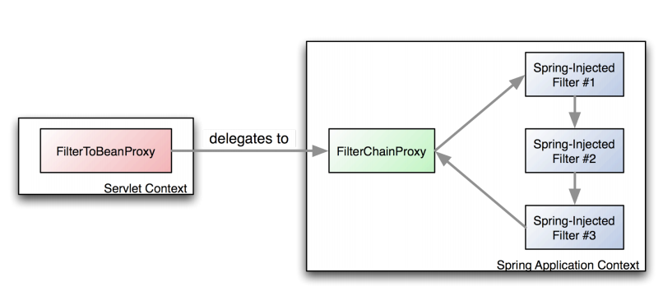
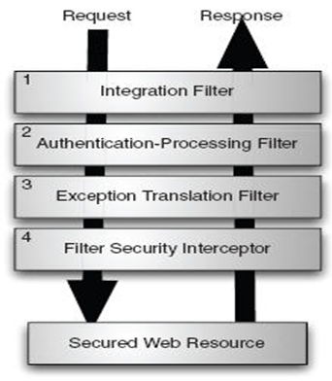
Filter Proxy
DelegatingFilterProxy
Notes:
Other principals: device, other system
These concepts are common, and not at all specific to Spring Security

Slide 10
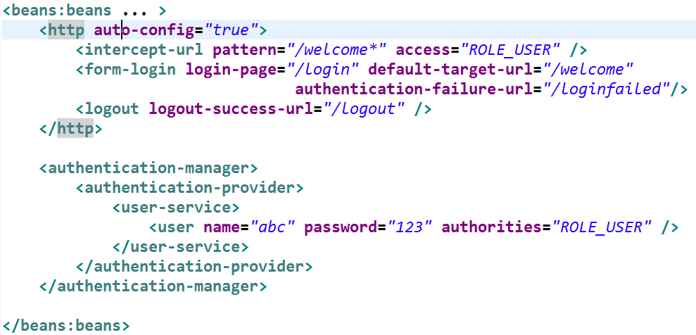
Configuration 2
WEB-INF/spring-security.xml:
Notes:
Other principals: device, other system
These concepts are common, and not at all specific to Spring Security

Slide 11
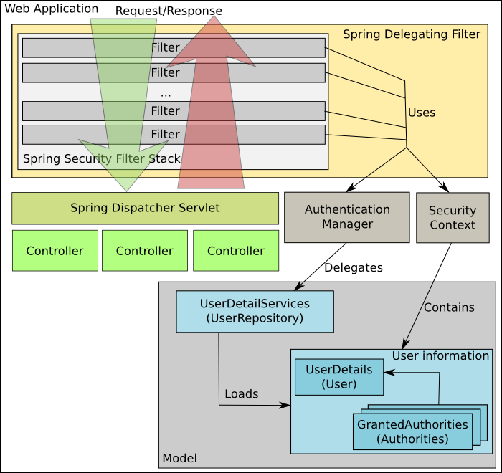
Basic Architecture
Notes:
Other principals: device, other system
These concepts are common, and not at all specific to Spring Security

Slide 12
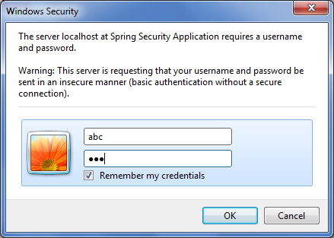
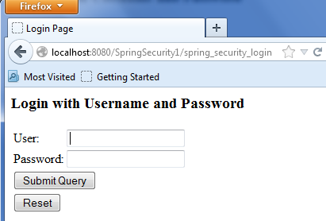
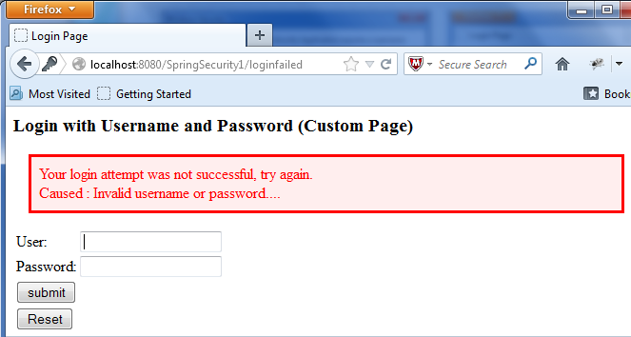
CODE DEMO 1 - FORMS
HTTP BASIC
Default Form
Custom Form
with logout & custom error
Notes:
Other principals: device, other system
These concepts are common, and not at all specific to Spring Security

Slide 13
CODE DEMO 2 – AUTH PROVIDERS
Hashed password
Password from Database
Notes:
Other principals: device, other system
These concepts are common, and not at all specific to Spring Security

Slide 14
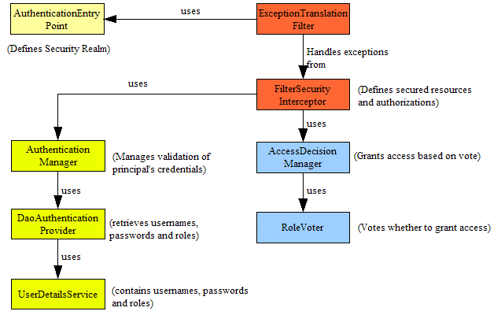
Authorization
Notes:
Out of the box we have three different decision managers. Each fires up a set of voters (a voter is responsible for either granting access, denying access or abstaining from voting) and gathers up the outcomes. AffirmativeBased decision manager will grant access if any voter said OK. UnanimousBased decision manager will grant access ONLY if all voters said OK. ConsensusBased decision manager will let the majority decide. It actually counts each vote. You can configure it to behave as you wish in case of a tie.

Slide 15
Authorization
Authorized access
Customized access denied page
Notes:
Other principals: device, other system
These concepts are common, and not at all specific to Spring Security

Slide 16
Major operations
Authentication
Authorization(WebURL, Method Invocation, Domain based security ACL)
Channel Security
Human user detection(CAPTCHA)
Web Service Security (via Spring Web Services)
Flow Authorization(via Spring Web Flow)
Remember me, Detecting Timeouts, Concurrent Session Control
Focus is on webapps but works well with batch job, rich clients, integrated tests & other platforms.
Notes:
Other principals: device, other system
These concepts are common, and not at all specific to Spring Security
Channel security against evesdropper and man in the middle attacks

Slide 17
<http>:The Magic Element
The central conﬁguration element for web security
•<intercept-url> declares a page to be secured (and how it should be secured)
•<form-login> refers to a login page
•The auto-conﬁg attribute automatically conﬁgures support HTTP Basic authentication, Logout, Remember-Me, and Anonymous sessions
*In fact, it also automatically creates a login page
for you.
Notes:
Other principals: device, other system
These concepts are common, and not at all specific to Spring Security

Slide 18
<http>:The Magic Element
May also contain...
•<form-login>
•<http-basic>
•<intercept-url>
•<logout>
•<access-denied-handler>
•<anonymous>
•<concurrency-control>
•<openid-login>
•<port-mappings>
•<remember-me>
•<session-management>
•<x509>
Notes:
Other principals: device, other system
These concepts are common, and not at all specific to Spring Security

Slide 19
<http>:The Magic Element
Has these attributes
•servlet-api-provision
•path-type
•lowercase-comparisons
•realm
•entry-point-ref
•access-decision-manager-ref
•access-denied-page
•once-per-request
•create-session
Notes:
Other principals: device, other system
These concepts are common, and not at all specific to Spring Security

Slide 20
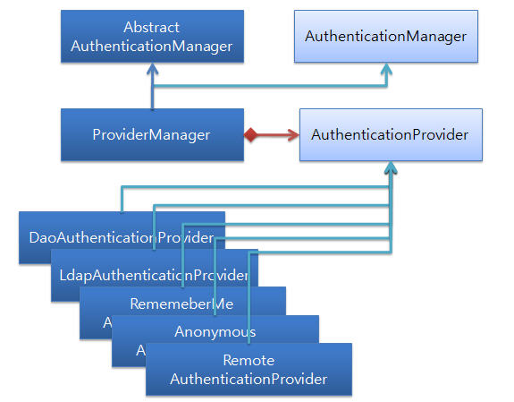
Provider
Notes:
Other principals: device, other system
These concepts are common, and not at all specific to Spring Security

Slide 21
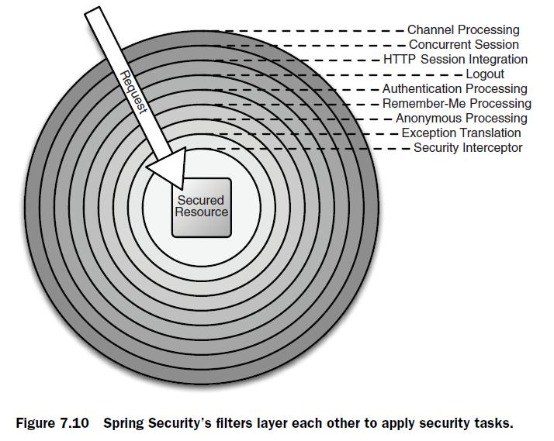
Filter Layer
Notes:
Other principals: device, other system
These concepts are common, and not at all specific to Spring Security

Slide 22
Authentication
Several choices
•Form
•Basic
•LDAP
•Kerberos
•Container (eg. Tomcat)
•JAAS
•JA-SIG CAS
•OpenID
•SiteMinder
•Atlassian Crowd
•OpenID
•X.509
•Digest
Notes:
Other principals: device, other system
These concepts are common, and not at all specific to Spring Security

